Slide 1
Characterization of Disease Resistance Loci in the USDA Soybean Germplasm Collection Using Genome-Wide Association Studies Hao-Xun Chang, Alexander E. Lipka, Leslie L. Domier, and Glen L. Hartman
Under-caffeinated and Underpaid
Colton McNinch, Johnathon Shook, Benjamin Trampe, Kevin Falk
EEOB 546X
December 8, 2017

Slide 2
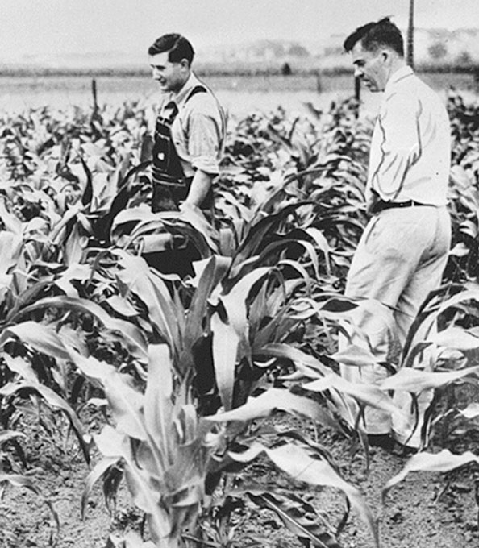
Outline
Background
Soybean
GWAS
Pipeline workflow
Genotype & Phenotype data
GAPIT & Beagle
For Loop
Results
Summary

Slide 3
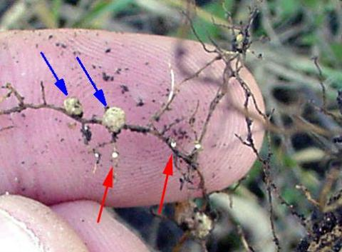
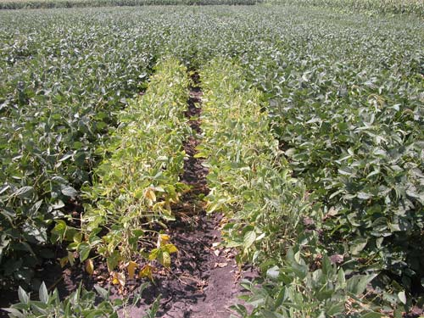
Background
Soybean (Glycine max)
oilseed crop
protein and vegetable oil
US production of ~$35-45B.
Biotic & Abiotic stress resistance
Soybean cyst nematode
diseases
Resistance genes
often rare and unknown
identification is crucial
https://fyi.uwex.edu/fieldcroppathology/soybean_pests_diseases/sds/

Slide 4
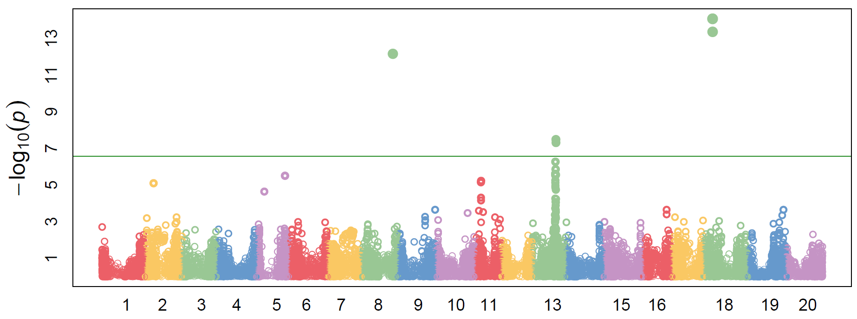
Why GWAS?
USDA has 20,000+ accessions of soybeans from across the world in their collection, including improved soybeans, landraces, and wild soybeans.
These have been genotypes with a standard “50k” chip, and ~43000 markers are available for each accession.
The low frequency of individual disease resistance genes makes GWAS ideal for identifying candidates. LD also decays slowly enough to provide several markers associated with a gene.

Slide 5
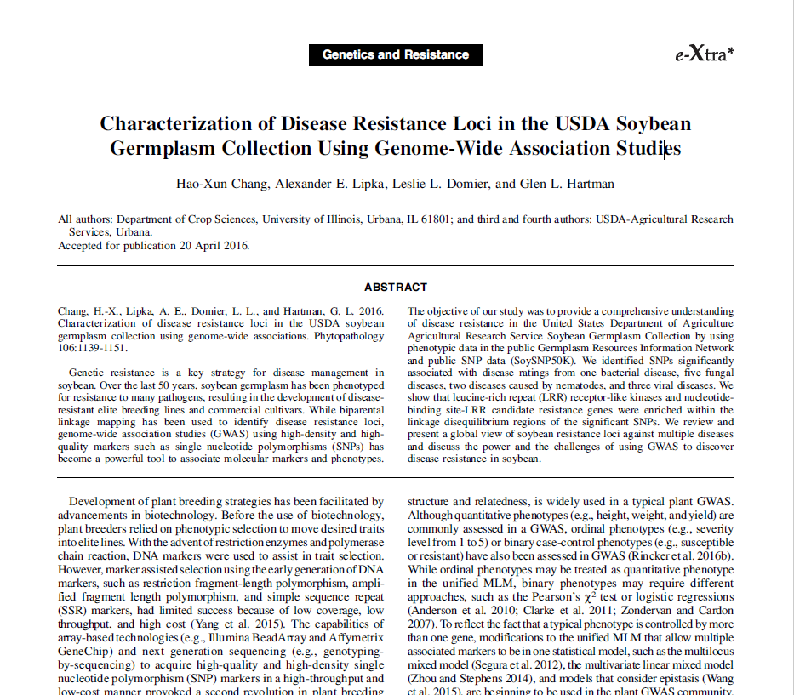
Old News is New News
Massive screening efforts have taken place prior to the initiation of genotyping efforts in soybean.
This data, originally used to find lines to use in breeding programs, can now be used in conjunction with marker data to identify underlying genes.
Many other historical, community resources may exist with the possibility of shedding new light on old questions.

Slide 6
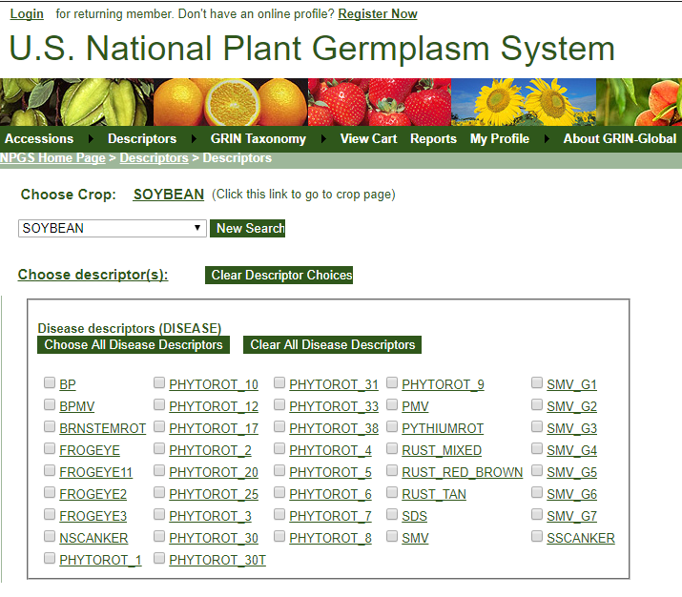
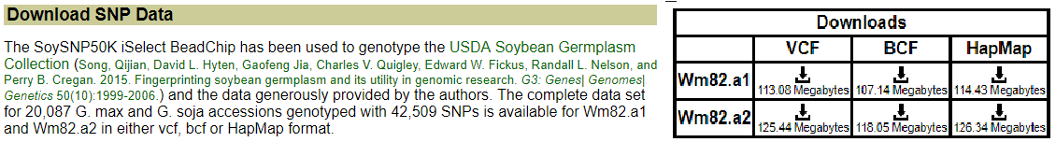
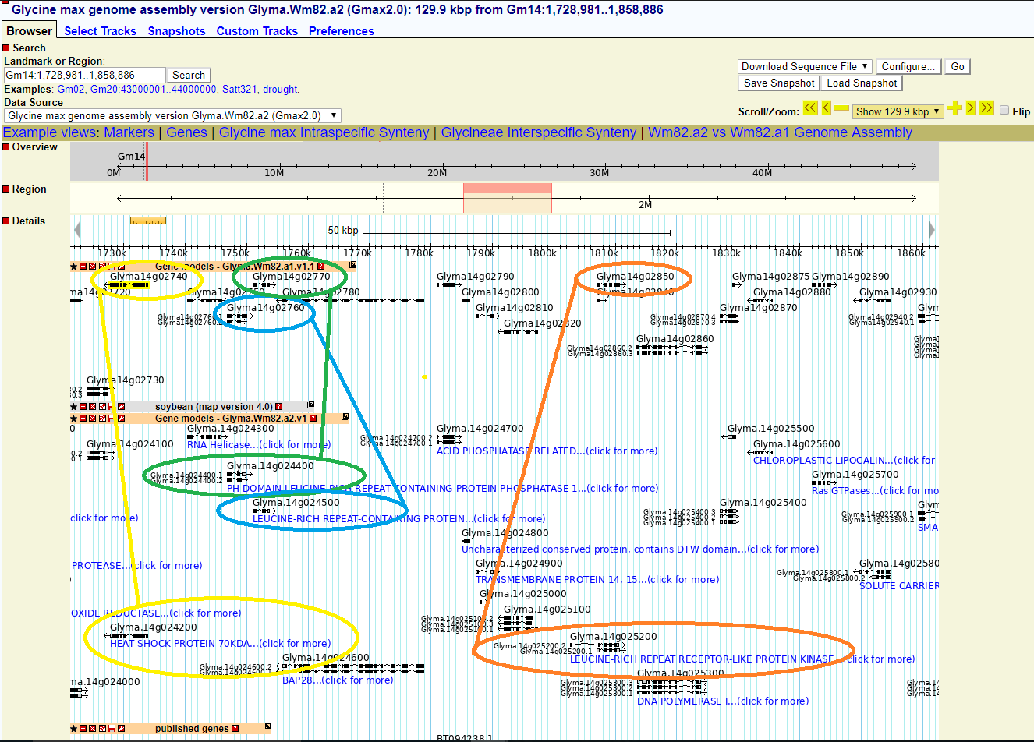
GWAS Pipeline Workflow
Steps:
Download SNPs from SoyBase.org for all accessions
Impute missing markers with Beagle 4.1 (Java app)
Acquire phenotype files from USDA website (npgsweb.ars-grin.gov)
Replace measurements presented as S, MS, MR, R to 5, 4, 2, 1, respectively.
Analyze with MLM (mixed linear model)
Combine significant markers found into single file
Curate using SoyBase genome browser and original paper

Slide 7
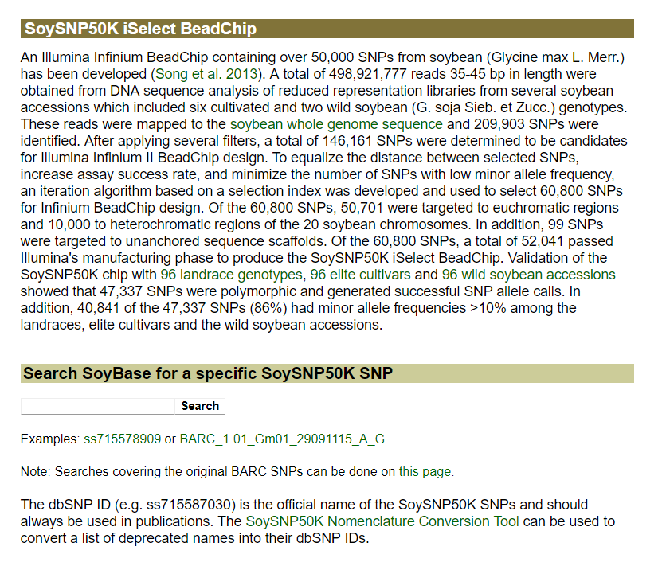
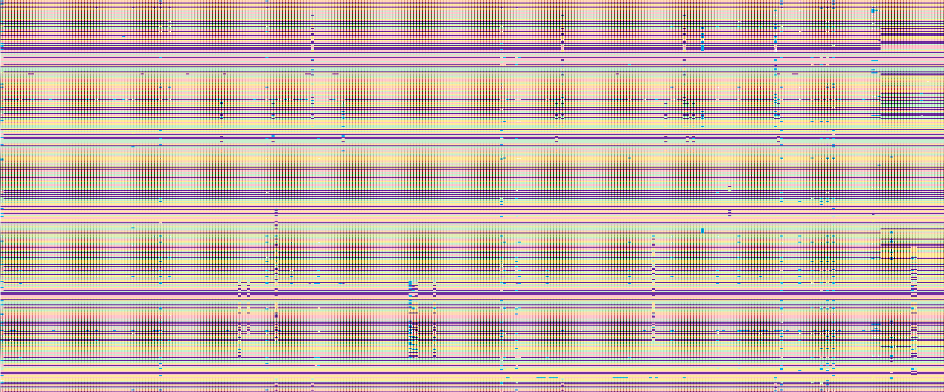
SoySNP50k Illumina Data
Visualizing the SNPs (each column is an accession)

Slide 8
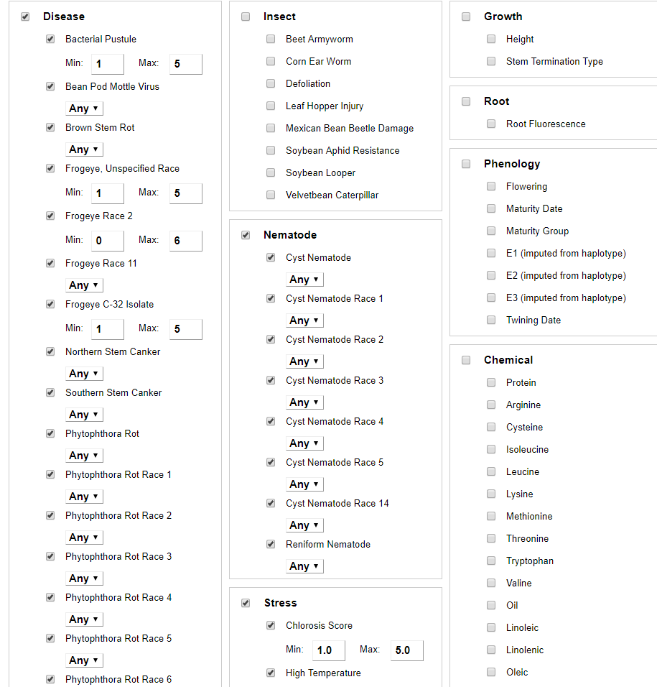
Acquiring Phenotype data from the USDA
Phenotypic traits of interest can be selected and downloaded together as one file
This approach does not include experiment and location information
Outside the original paper’s scope but something we were interested in
To acquire this information each test must be downloaded separately
This data dates back to 1964
Qualitative measurements

Slide 9
Beagle 4.1
Accurate genotype imputation algorithm
Accurate haplotype phasing algorithm
Identity by descent, homozygosity by decent algorithm
Beagle uses Variant Call Format (.VCF) format
Some data may be lost due to incorrect imputation in cases of indels
Due to time and computational constraints, imputation using Beagle 4.1 was performed on all genotypes in the USDA collection simultaneously rather than for individual panels.
This should actually improve imputation, but may change rare allele frequencies from original paper.

Slide 10
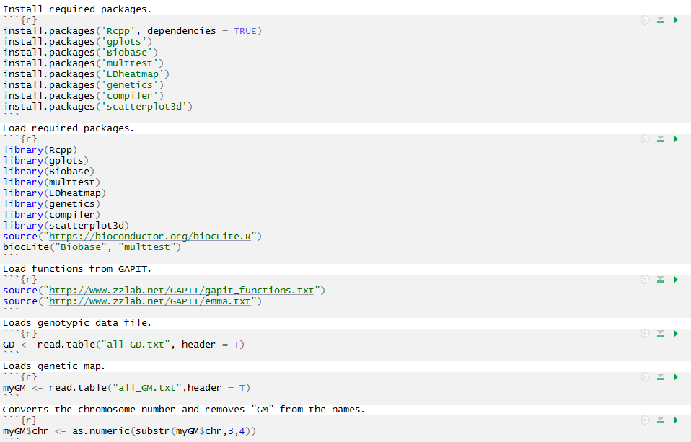
Installing Packages & Libraries
Install Packages
Load Libraries
GAPIT is basically an R package without technically being a ‘package’.
The code is sourced from a website at Washington State University

Slide 11

Genome Association and Prediction Integrated Tool
R package that performs Genome Wide Association Study (GWAS) and genome prediction (or selection).
Mixed Linear Model (MLM) is one of the most effective methods for controlling false positives in GWAS.
Plant breeding loves R packages
R is intuitive and using packages such as GAPIT is easy compared to other languages.

Slide 12
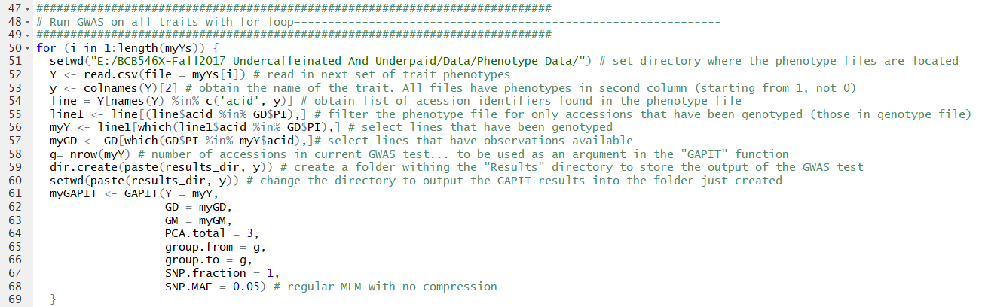
For loop
Our original code for this assignment was ~1200 lines
Using a for loop we were able to reduce this to 80 lines
The for loop runs through each file, analyzing each phenotype in column two of the dataframe

Slide 13
Results
Chang et al.
Under-caffeinated
Found 35 candidate genes
None of these have been functionally verified
The differences are likely due to MAF thresholds
Chang et al. 2016 reduced their threshold to 0.01 for populations of size n > 2000
Williams_82_v1 genome construction
33 / 35 genes found by Chang et al. confirmed
3 genes located that were not reported by Chang et al.
Used a MAF of 0.05 for the entire analysis
Williams_82_v2 genome construction
All positions were reported with Williams_82_v2 due to improved reference genome quality.
Populations with size < 200 were excluded from our analyses.
Resistance to Phytophora Root Rot race 11
GLYMA-11G233500
Leucine rich repeat receptor like kinase
Located in root

Slide 14
Differences in our Analyses
Due to time and computational constraints, imputation using Beagle 4.1 was performed on all genotypes in the USDA collection simultaneously rather than for individual panels.
This should actually improve imputation, but may change rare allele frequencies from original paper.
Williams_82_v1 used for original paper

Slide 15
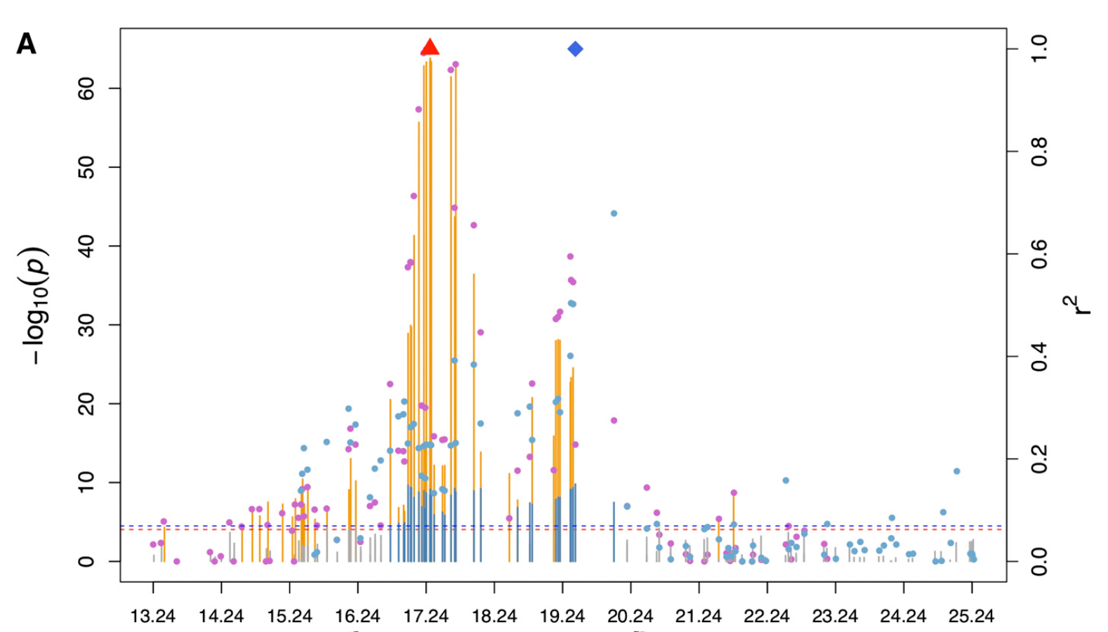
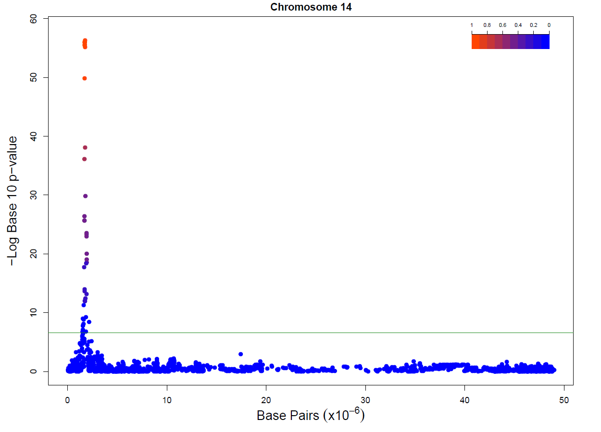
Chromosome 14: Northern Diaporthe Stem Canker Resistance
Williams_82_v1
Williams_82_v2
Chang et al.
U&U

Slide 16
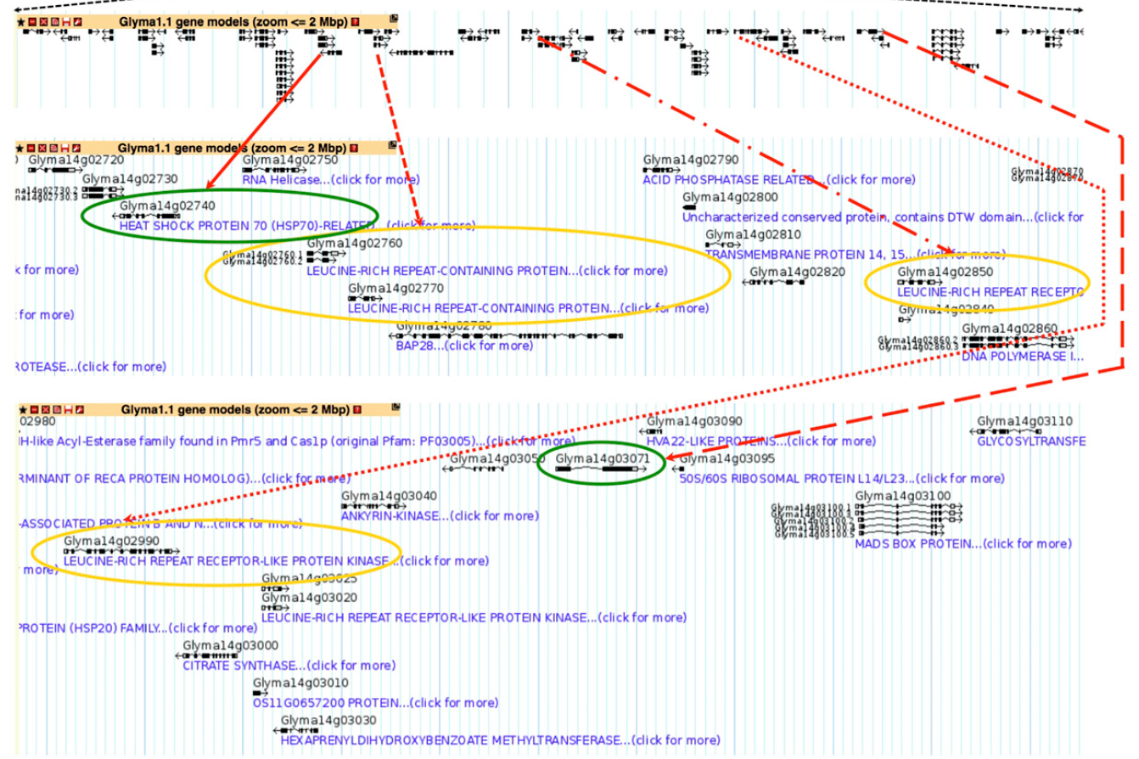
Gene Identification using Soybase
Chang et al.
U&U

Slide 17
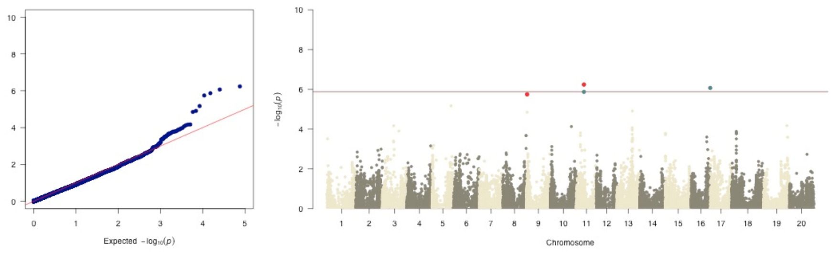
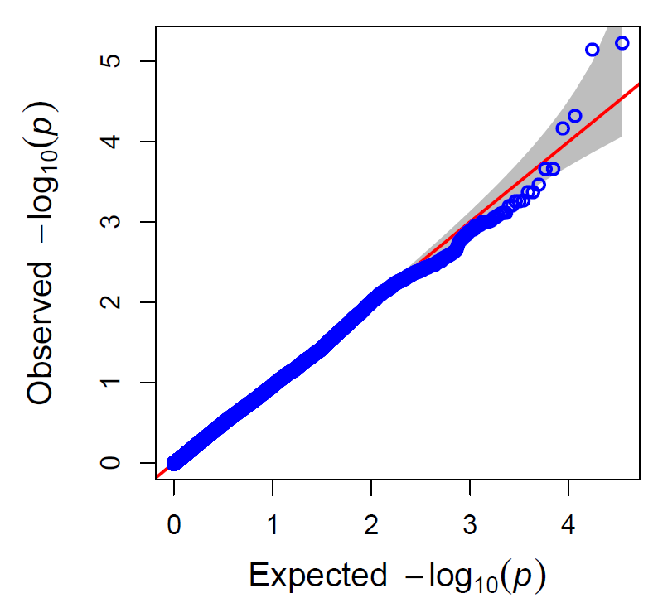
SDS Comparison of QQ & Manhattan Plots
0.01 MAF
Chang et al.
0.05 MAF
U&U

Slide 18
Summary
Successes
Located For Loop construction
33 / 35 genes found by Chang et al. confirmed
3 genes located that were not reported by Chang et al.
Corresponded with Soybase.org curators to update missing online genotypic data
Failures
Originally used 1200 lines of code
Documentation lacking
Unable to know imputation settings
Compression for MLM
Missing genotypes
Creation of Manhattan Plots

Slide 19


Slide 20
Description of the Group
John
Scraped USDA webpage to acquire data
Initialization of R code
Benjamin
Comparison of results
Markdown containing pipeline documentation
Kevin
Soybase gene identification
Presentation
Colton
Data imputation using Beagle software
For loop to pare down the code

